Slide 1
Unit V
Exploring swing

Slide 2
Outline
Java Swing Overview
Features
Controls- Components & Containers
Layouts
Menus

Slide 3
SWING - Overview
Swing API is a set of extensible GUI Components to ease the developer's life to create JAVA based Front End/GUI Applications.
It is built on the top of AWT (Abstract Windowing Toolkit) API and entirely written in java.
It acts as a replacement of AWT API, since it has almost every control corresponding to AWT controls.
Unlike AWT, Java Swing provides platform-independent and lightweight components.

Slide 4
Swing component follows a Model-View-Controller architecture to fulfill the following criteria's.
A single API is to be sufficient to support multiple look and feel.
API is to be model driven so that the highest level API is not required to have data.
API is to use the Java Bean model so that Builder Tools and IDE can provide better services to the developers for use.

Slide 5
MVC Architecture
Swing API architecture follows loosely based MVC architecture in the following manner.
Model represents component's data.
View represents visual representation of the component's data.
Controller takes the input from the user on the view and reflects the changes in Component's data.
Swing component has Model as a separate element, while the View and Controller part are clubbed in the User Interface elements. Because of which, Swing has a pluggable look-and-feel architecture.

Slide 6
Swing Features
Light Weight − Swing components are independent of native Operating System's API as Swing API controls are rendered mostly using pure JAVA code instead of underlying operating system calls.
Rich Controls − Swing provides a rich set of advanced controls like Tree, TabbedPane, slider, colorpicker, and table controls.
Highly Customizable − Swing controls can be customized in a very easy way as visual apperance is independent of internal representation.
Pluggable look-and-feel − SWING based GUI Application look and feel can be changed at run-time, based on available values.

Slide 7
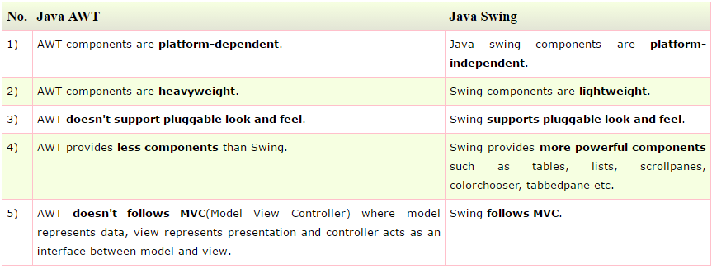
Difference b/w AWT & Swing

Slide 8
SWING - Controls
Every user interface considers the following three main aspects −
UI Elements − These are the core visual elements the user eventually sees and interacts with.
Layouts − They define how UI elements should be organized on the screen and provide a final look and feel to the GUI (Graphical User Interface).
Behavior − These are the events which occur when the user interacts with UI elements.

Slide 9
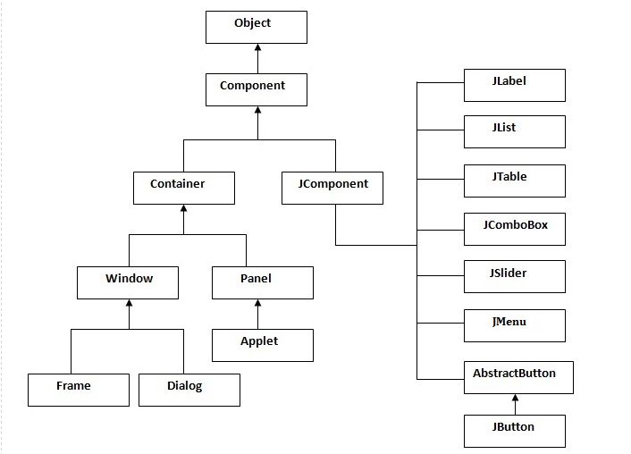
Hierarchy of Java Swing class

Slide 10
Component class hiearchy
Component- A Component is the abstract base class for the non menu user-interface controls of SWING. Component represents an object with graphical representation
Container- A Container is a component that can contain other SWING components
Jcomponent- A JComponent is a base class for all SWING UI components. In order to use a SWING component that inherits from JComponent, the component must be in a containment hierarchy whose root is a top-level SWING container

Slide 11
Swing Components

Slide 12
SWING UI Elements or Components
JLabel
Jbutton
JTextField
JTextArea
JPasswordField
JCheck Box
JRadioButton
JComboBox
JTable
JList
JOptionPane
JScrollbar
JColorChooser
JSlider
Jspinner
Jtree
JTabbedPane
JLayeredPane
JProgressBar
JFileChooser

Slide 13
1. JLabel
The object of JLabel class is a component for placing text in a container.
It is used to display a single line of read only text.
The text can be changed by an application but a user cannot edit it directly.
It inherits JComponent class.
JLabel class declaration
public class JLabel extends JComponent implements SwingConstants,
Accessible

Slide 14
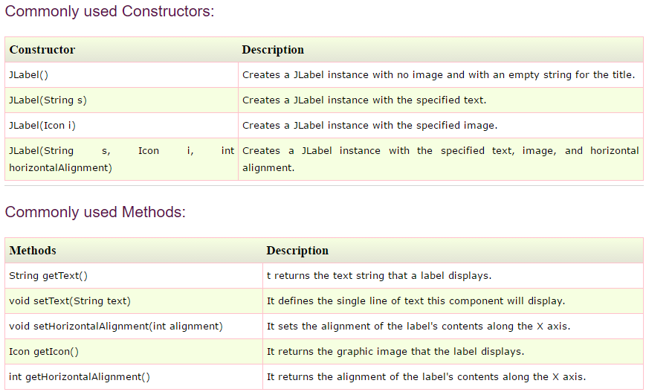

Slide 15
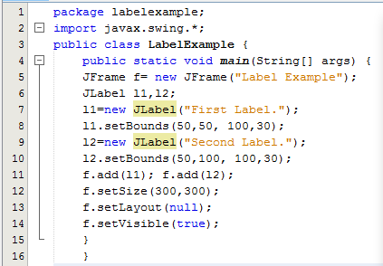
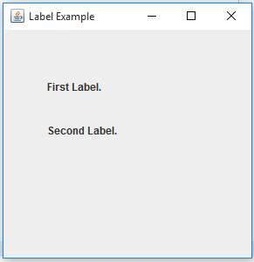
Java JLabel Example

Slide 16
2.JButton
The JButton class is used to create a labeled button that has platform independent implementation.
The application result in some action when the button is pushed.
It inherits AbstractButton class.
JButton class declaration
public class JButton extends AbstractButton implements Accessible

Slide 17
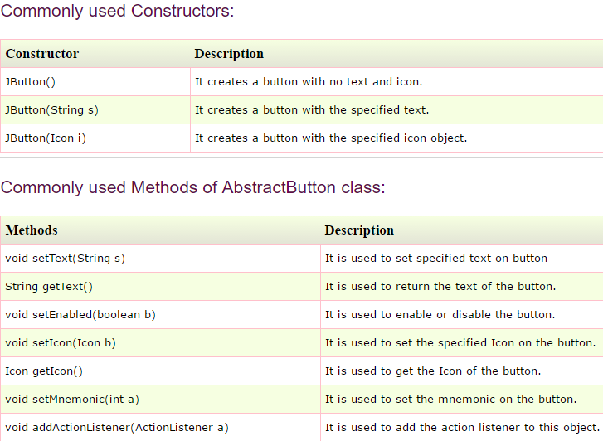

Slide 18
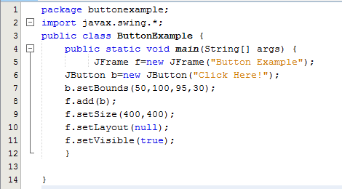
Java JButton Example

Slide 19
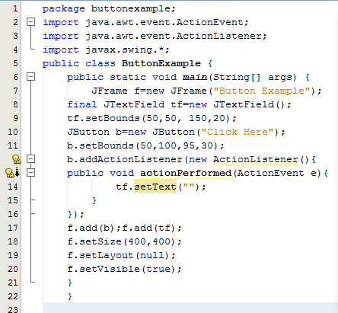
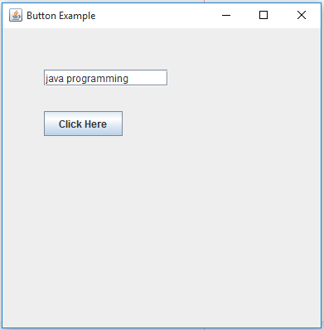
Java JButton Example with ActionListener

Slide 20
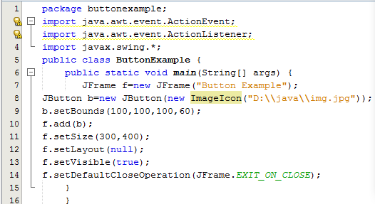
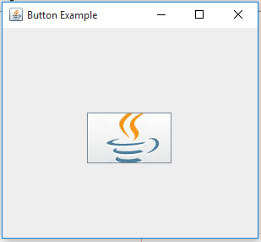
Displaying image on the button

Slide 21
3. Java JTextField
The object of a JTextField class is a text component that allows the editing of a single line text.
It inherits JTextComponent class.
JTextField class declaration
public class JTextField extends JTextComponent implements SwingConstants

Slide 22
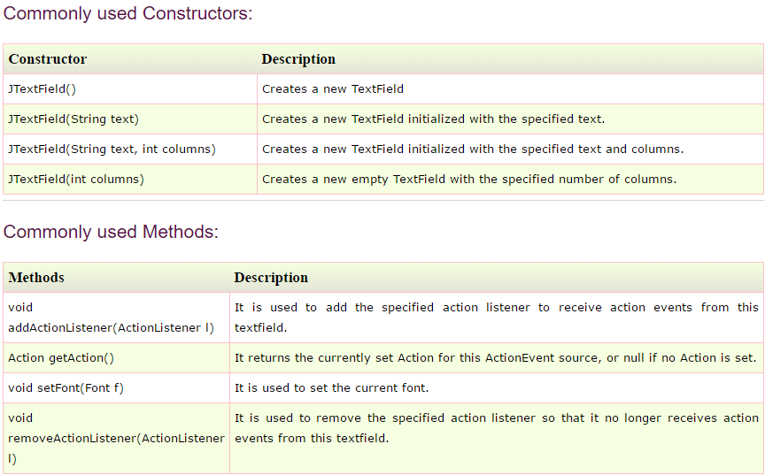

Slide 23
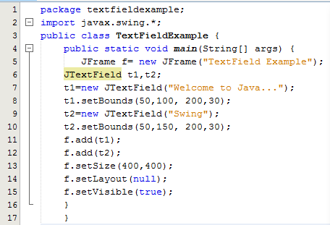
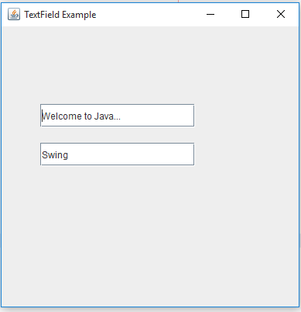
Java JTextField Example

Slide 24
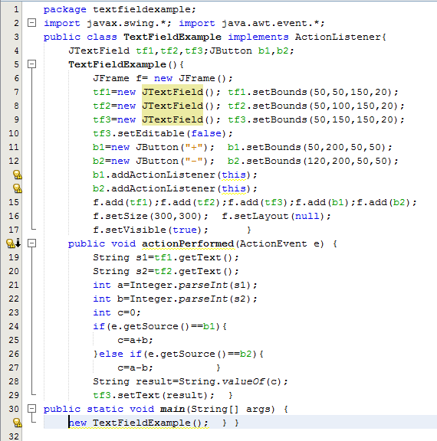
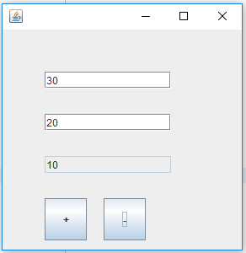
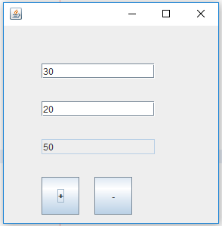

Slide 25
4.JTextArea
The object of a JTextArea class is a multi line region that displays text.
It allows the editing of multiple line text.
It inherits JTextComponent class
JTextArea class declaration
public class JTextArea extends JTextComponent

Slide 26
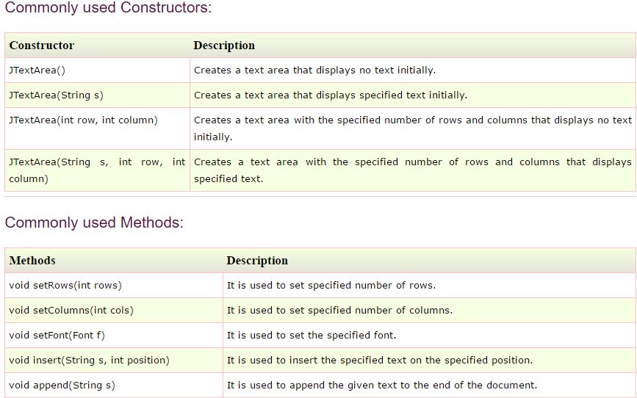

Slide 27
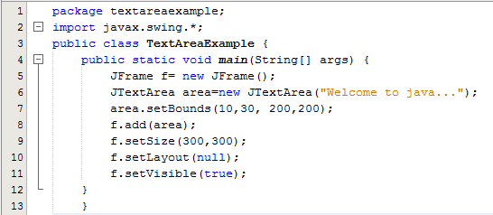
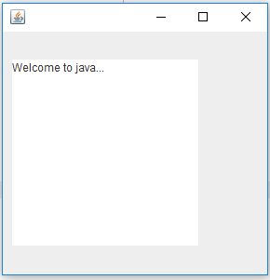
Java JTextArea Example

Slide 28
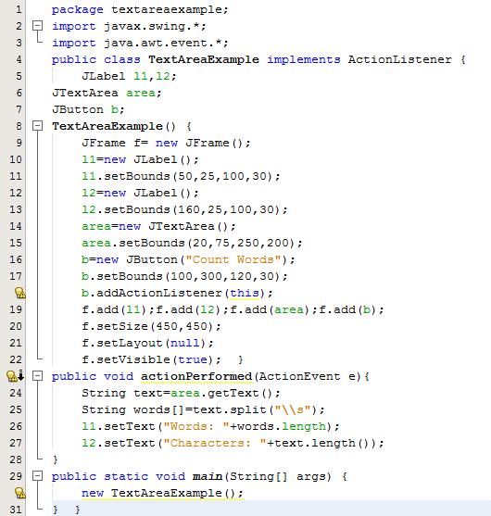
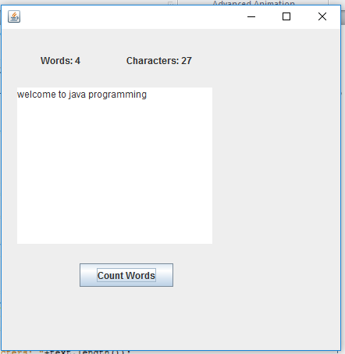

Slide 29
5. JPasswordField
The object of a JPasswordField class is a text component specialized for password entry.
It allows the editing of a single line of text.
It inherits JTextField class.
JPasswordField class declaration
public class JPasswordField extends JTextField

Slide 30
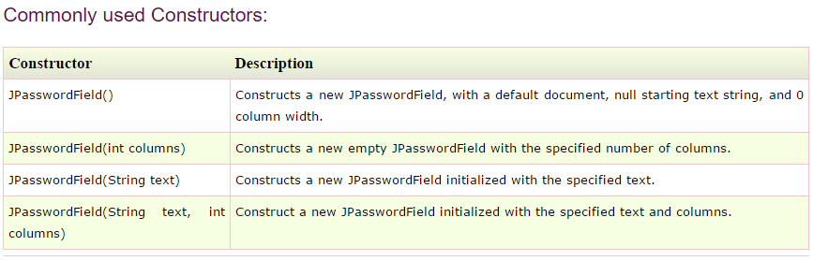

Slide 31
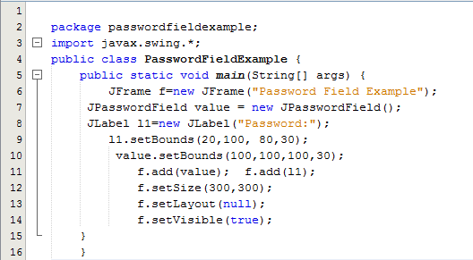
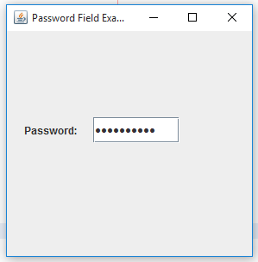
Java JPasswordField Example

Slide 32
6.JCheckBox
The JCheckBox class is used to create a checkbox.
It is used to turn an option on (true) or off (false).
Clicking on a CheckBox changes its state from "on" to "off" or from "off" to "on “.
It inherits JToggleButton class.
Declaration
public class JCheckBox extends JToggleButton implements Accessible

Slide 33
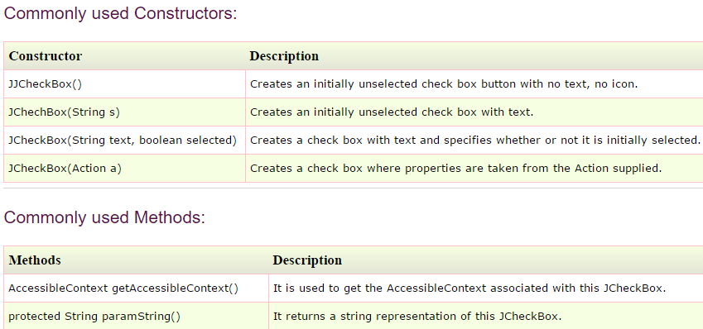

Slide 34
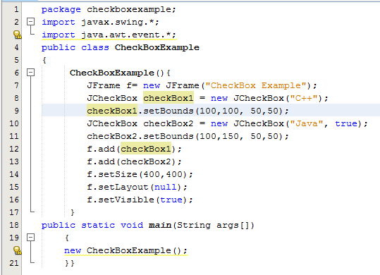
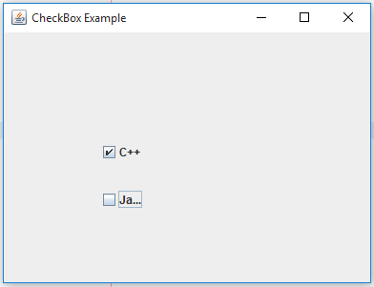
JCheckBox Example

Slide 35
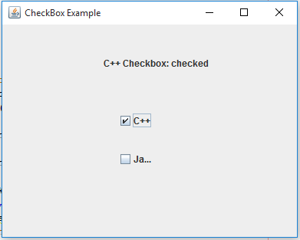
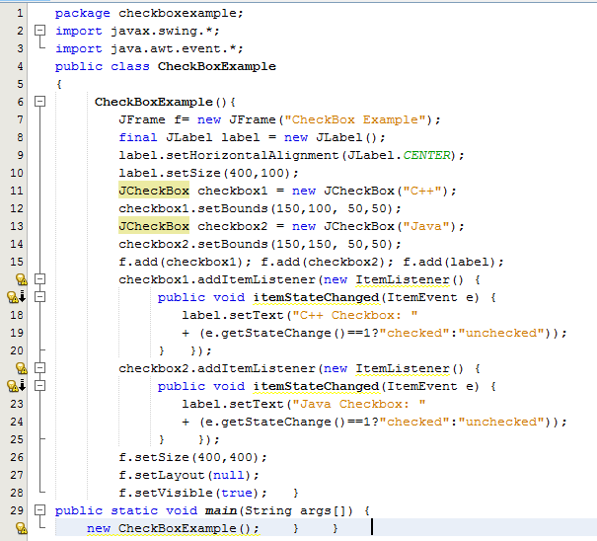
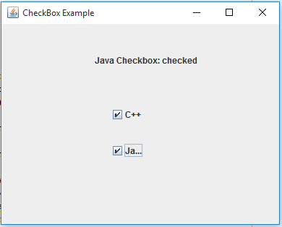
JCheckBox Example with ItemListener

Slide 36
7.JRadioButton
The JRadioButton class is used to create a radio button.
It is used to choose one option from multiple options.
It is widely used in exam systems or quiz.
It should be added in ButtonGroup to select one radio button only.
Declaration
public class JRadioButton extends JToggleButton implements Accessible

Slide 37
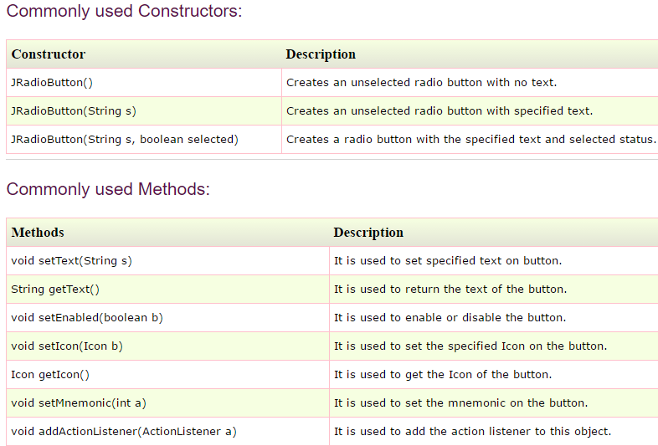

Slide 38
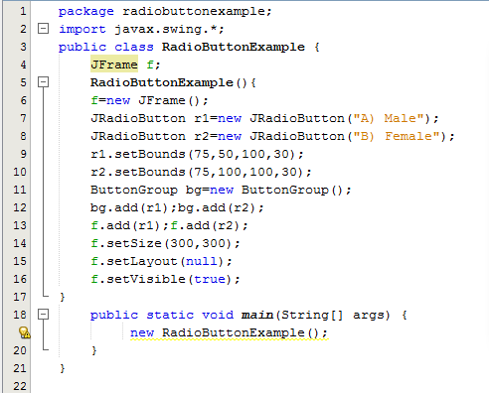
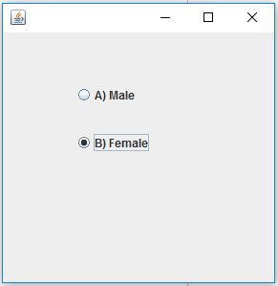
JRadioButton Example

Slide 39
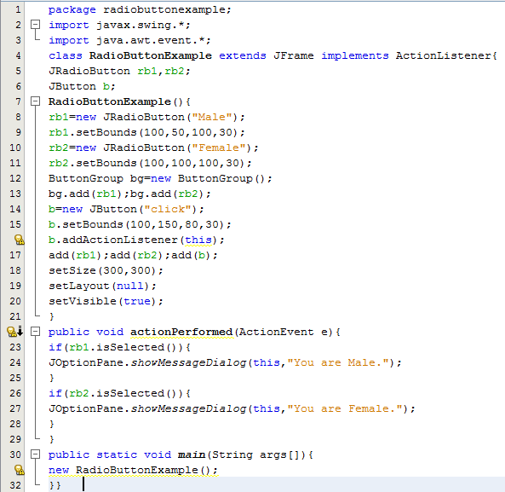
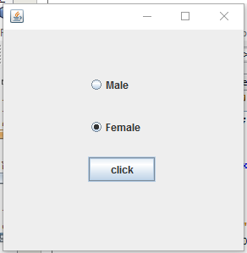
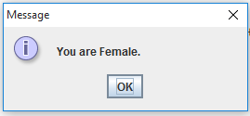
JRadioButton Example with ActionListener

Slide 40
8.JComboBox
The object of Choice class is used to show popup menu of choices.
Choice selected by user is shown on the top of a menu.
It inherits JComponent class.
Declaration
public class JComboBox extends JComponent implements
ItemSelectable, ListDataListener, ActionListener, Accessible

Slide 41
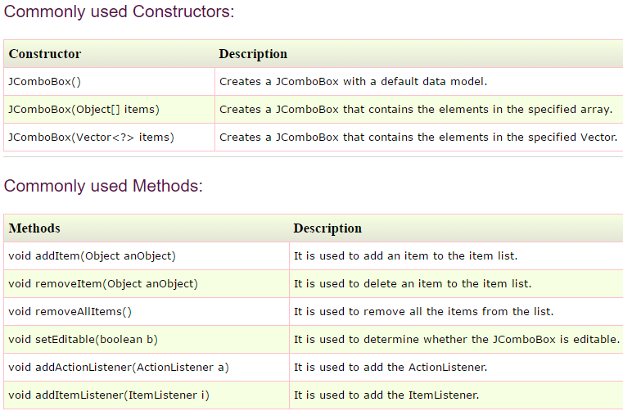

Slide 42
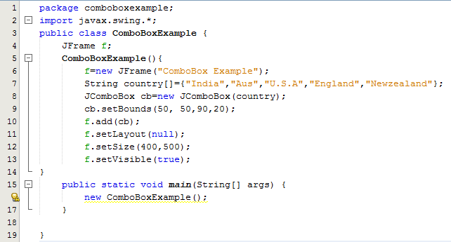
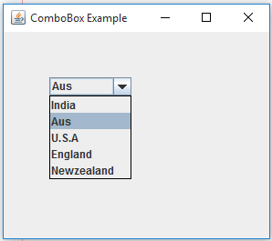
JComboBox Example

Slide 43
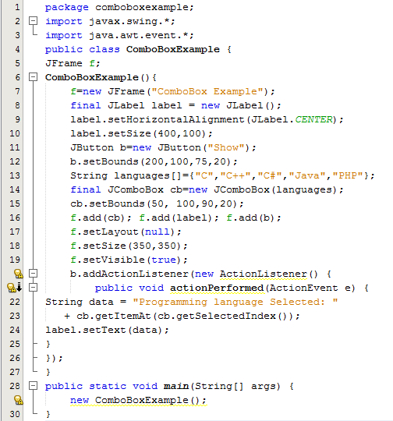
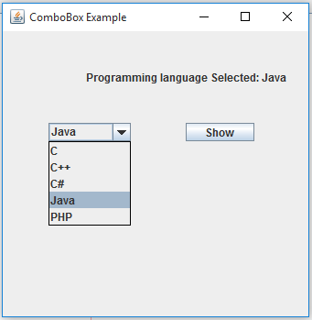
JComboBox Example with ActionListener

Slide 44
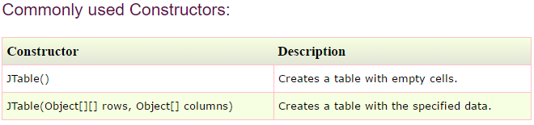
9.JTable
The JTable class is used to display data in tabular form.
It is composed of rows and columns.

Slide 45
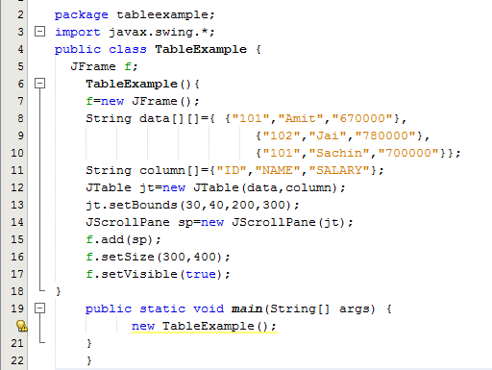
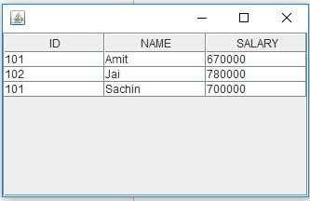
JTable Example

Slide 46
10. JList
The object of JList class represents a list of text items.
The list of text items can be set up so that the user can choose either one item or multiple items.
It inherits JComponent class.
JList class declaration
public class JList extends JComponent implements Scrollable, Accessible

Slide 47
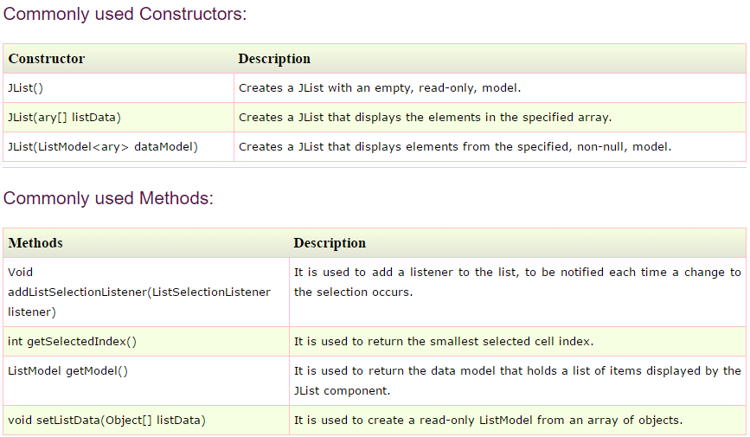

Slide 48
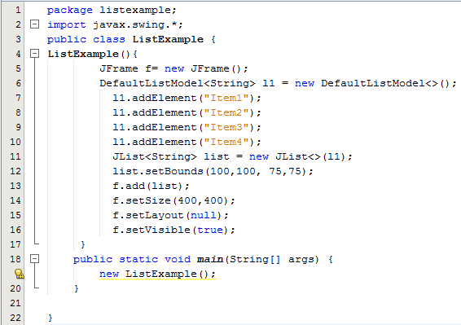
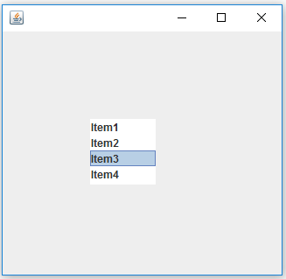
JList Example

Slide 49
11. JOptionPane
The JOptionPane class is used to provide standard dialog boxes such as message dialog box, confirm dialog box and input dialog box.
These dialog boxes are used to display information or get input from the user.
The JOptionPane class inherits JComponent class.
JOptionPane class declaration
public class JOptionPane extends JComponent implements Accessible

Slide 50
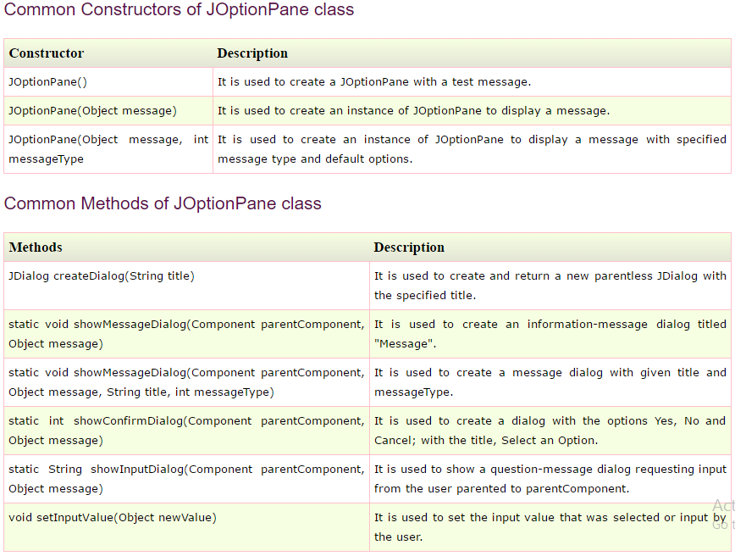

Slide 51
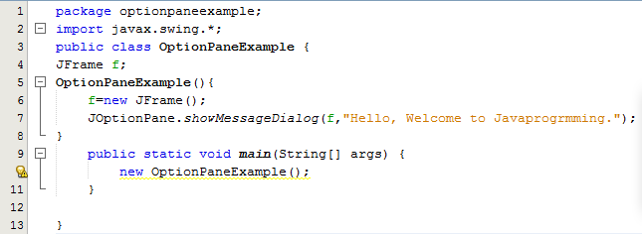

JOptionPane Example: showMessageDialog()

Slide 52


JOptionPane Example: showalertDialog()

Slide 53


JOptionPane Example: showInputDialog()

Slide 54

12. JScrollBar
The object of JScrollbar class is used to add horizontal and vertical scrollbar.
It is an implementation of a scrollbar.
It inherits JComponent class.
JScrollBar class declaration
public class JScrollBar extends JComponent implements Adjustable, Accessible

Slide 55


JScrollBar Example

Slide 56
13. JColorChooser
The JColorChooser class is used to create a color chooser dialog box so that user can select any color.
It inherits JComponent class.
JColorChooser class declaration
public class JColorChooser extends JComponent implements Accessible

Slide 57


Slide 58

JColorChooser Example

Slide 59

JColorChooser Example

Slide 60

JColorChooser Example

Slide 61
14. JSlider
The Java JSlider class is used to create the slider.
By using JSlider, a user can select a value from a specific range.

Slide 62


Slide 63


JSlider Example

Slide 64
15. JSpinner
The object of JSpinner class is a single line input field that allows the user to select a number or an object value from an ordered sequence.
JSpinner class declaration
public class JSpinner extends JComponent implements
Accessible

Slide 65


Slide 66


JSpinner Example

Slide 67

16. JTree
The JTree class is used to display the tree structured data or hierarchical data.
JTree is a complex component.
It has a 'root node' at the top most which is a parent for all nodes in the tree.
It inherits JComponent class.
JTree class declaration
public class JTree extends JComponent implements Scrollable, Accessible

Slide 68

JTree Example

Slide 69

JTree Example

Slide 70

17. JTabbedPane
The JTabbedPane class is used to switch between a group of components by clicking on a tab with a given title or icon.
It inherits JComponent class.
JTabbedPane class declaration
public class JTabbedPane extends JComponent implements Serializable, Accessible, SwingConstants

Slide 71


JTabbedPane Example

Slide 72

18. JLayeredPane
The JLayeredPane class is used to add depth to swing container.
It is used to provide a third dimension for positioning component and divide the depth-range into several different layers.
JLayeredPane class declaration
public class JLayeredPane extends JComponent implements Accessible

Slide 73


JLayeredPane Example

Slide 74
19. JProgressBar
The JProgressBar class is used to display the progress of the task. It inherits JComponent class.
JProgressBar class declaration
public class JProgressBar extends JComponent implements SwingConstants, Accessible

Slide 75


Slide 76


JProgressBar Example

Slide 77

20. JFileChooser
The object of JFileChooser class represents a dialog window from which the user can select file.
It inherits JComponent class.
JFileChooser class declaration
public class JFileChooser extends JComponent implements Accessible

Slide 78

JFileChooser Example

Slide 79

JFileChooser Example

Slide 80
Swing Containers

Slide 81
SWING - Containers
Containers are an integral part of SWING GUI components.
A container provides a space where a component can be located.
A Container in AWT is a component itself and it provides the capability to add a component to itself.
Following points to be considered
Sub classes of Container are called as Container. For example, JPanel, JFrame and JWindow.
Container can add only a Component to itself.
A default layout is present in each container which can be overridden using setLayout method.

Slide 82
Containers
Commonly used containers for designing GUI using SWING.
Panel
Frame
Window

Slide 83

1.JPanel
The JPanel is generic lightweight container.
It provides space in which an application can attach any other component.
JPanel class declaration
public class JPanel extends JComponent implements Accessible

Slide 84

JPanel Example

Slide 85

JPanel Example

Slide 86
2. JFrame
JFrame is an extended version of java.awt.Frame that adds support for the JFC/Swing component architecture.
Class Declaration
public class JFrame extends Frame implements WindowConstants, Accessible, RootPaneContainer

Slide 87


Jframe Example

Slide 88
3. JWindow
JWindow is a container that can be displayed but does not have the title bar or window-management buttons.
This type of window is usually used to display messages like welcome messages, Copyright information, etc.
Constructor: JWindow ()

Slide 89


Jwindow Example

Slide 90


Jwindow Example

Slide 91
Swing Layouts

Slide 92
Layout Managers
The layout manager automatically positions all the components within the container.
Even if you do not use the layout manager, the components are still positioned by the default layout manager.
The layout manager is associated with every Container object.
A layout manager is an instance of any class that implements the LayoutManager interface
Method: void setLayout(LayoutManager layoutObj)
Types of Layouts:
FlowLayout
BorderLayout
GridLayout
CardLayout
GridBagLayout
GroupLayout
SpringLayout

Slide 93
2 major advantages of automatic layout manager:
It is very tedious to manually lay out a large number of components.
Sometimes the width and height information is not yet available when you need to arrange some control
Other methods:
setBounds( ) → used to determine the shape and position of each component manually

Slide 94
a) FlowLayout
It is the default layout manager
It implements a simple layout style
The direction of the layout is governed by the container’s component orientation property (left to right and top to bottom)
It centers components and leaves five pixels of space between each component
Constructors:
FlowLayout(): creates a flow layout with centered alignment and a default 5 unit horizontal and vertical gap.
FlowLayout(int align): creates a flow layout with the given alignment and a default 5 unit horizontal and vertical gap.
FlowLayout(int align, int hgap, int vgap): creates a flow layout with the given alignment and the given horizontal and vertical gap.

Slide 95
“align” has the following values:
FlowLayout.LEFT
FlowLayout.CENTER
FlowLayout.RIGHT
FlowLayout.LEADING
FlowLayout.TRAILING

Slide 96



Slide 97

b) BorderLayout
This implements a common layout style for top-level windows.
Divides the screen into 5 components:
North, South, East, West, Center
Constructors:
BorderLayout( )
BorderLayout(int horz, int vert)
Adding Components: void add(Component compObj, Object region)
Constants used:

Slide 98



Slide 99
c) GridLayout
GridLayout arranges the components in a rectangular grid
Should define the number of rows and columns
Constructors:
GridLayout( ) – generates single column grid
GridLayout(int numRows, int numColumns)
GridLayout(int numRows, int numColumns, int horz, int vert) – inserts space between the components

Slide 100



Slide 101
d) CardLayout
The CardLayout class manages the components in such a manner that only one component is visible at a time. It treats each component as a card that is why it is known as CardLayout.
Each layout can be thought of as being on a separate index card in a deck that can be shuffled so that any card is on top at a given time
The cards are typically held in an object of type Panel.
2 Constructors:
CardLayout( ) - creates a card layout with zero horizontal and vertical gap.
CardLayout(int horz, int vert) – creates a card layout with the given horizontal and vertical gap.

Slide 102


Slide 103




Slide 104
e) GridBagLayout
Used to specify the relative placement of components by specifying their positions within cells inside a grid
Each component can be a different size, and each row in the grid can have a different number of columns.
Hence Gridbag = a collection of small grids joined together
The location and size of each component in a grid bag are determined by a set of constraints → GridBagConstraints
Constraints include the height and width of a cell, and the placement of a component, its alignment, and its anchor point

Slide 105



Constructors: GridBagLayout( )
Setting constraints:
void setConstraints(Component comp, GridBagConstraints cons)

Slide 106


Slide 107
f) GroupLayout
The GroupLayout hierarchically groups the components in order to position them in a Container.
Constructors: GroupLayout(Container host)
Creates a GroupLayout for the specified Container.
Class Declaration
public class GroupLayout extends Object implements LayoutManager2

Slide 108
g) SpringLayout
The class SpringLayout positions the children of its associated container according to a set of constraints.
Constructors - SpringLayout()
Creates a new SpringLayout.
Following are the Fields of SpringLayout
BASELINE | SOUTH
EAST | VERTICAL_CENTER
HEIGHT | WEST
HORIZONTAL_CENTER | WIDTH
NORTH

Slide 109



Slide 110
Swing Menus

Slide 111
JMenuBar, JMenu and JMenuItem
A menu bar displays a list of top-level menu choices.
Each choice is associated with a drop-down menu
Menu Bar ➔ one or more Menu objects ➔ list of MenuItem objects
MenuItem Object can be selected by an user

Slide 112

Declaration

Slide 113


JMenu Example

Slide 114

JPopupMenu
PopupMenu can be dynamically popped up at specific position within a component.
It inherits the JComponent class.
JPopupMenu class declaration
public class JPopupMenu extends JComponent implements Accessible, MenuElement

Slide 115


JPopupMenu Example

Slide 116
JSeparator
JSeparator class is used to provide a general purpose component for implementing divider lines.
It is used to draw a line to separate widgets in a Layout.
It inherits JComponent class.
JSeparator class declaration
public class JSeparator extends JComponent implements SwingConstants, Accessible

Slide 117


Slide 118


JSeparator Example 1

Slide 119


JSeparator Example 2

Slide 120
JCheckboxMenuItem
The JCheckboxMenuItem class represents a check box which can be included in a menu.
Selecting the check box in the menu changes the control's state from on to off or from off to on.
Class Declaration
public class JCheckBoxMenuItem extends JMenuItem implements SwingConstants, Accessible

Slide 121


JCheckboxMenuItem

Slide 122
JRadioButtonMenuItem
The JRadioButtonMenuItem class represents a radio button which can be included in a menu.
It is used to choose one option from multiple options.
It should be added in ButtonGroup to select one radio button only.
Class Declaration
public class JRadioButtonMenuItem extends JMenuItem implements Accessible

Slide 123


JRadioButtonMenuItem

Slide 124
Thank You

